Slide 1
UNIVERSITY HIGH AT SUNRISE MOUNTAIN

Slide 2
Agenda
What is University High? – an optional program for honors/AP students
Admission criteria & deadline (2nd semester)
Requirements
Benefits

Slide 3
What is University High?
AIM/Honors/AP classes, accelerated program – most rigorous courses Sunrise offers
Endorsement areas in English/History or Math/Science
High school and college/university credit
Community Service

Slide 4
Applications will be accepted – starting 2nd semester, 9th grade

Slide 5
Admission Criteria
Complete data sheet & turn in to guidance starting 2nd semester 9th grade year –
Successful completion of English I H or AIM English I
Successful completion of Pre-AP Biology
Grades: 3.25 or better, C’s or better

Slide 6
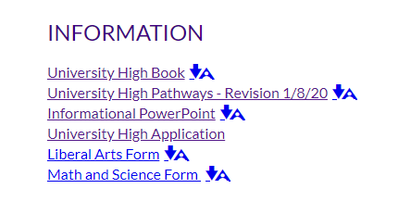

Slide 7
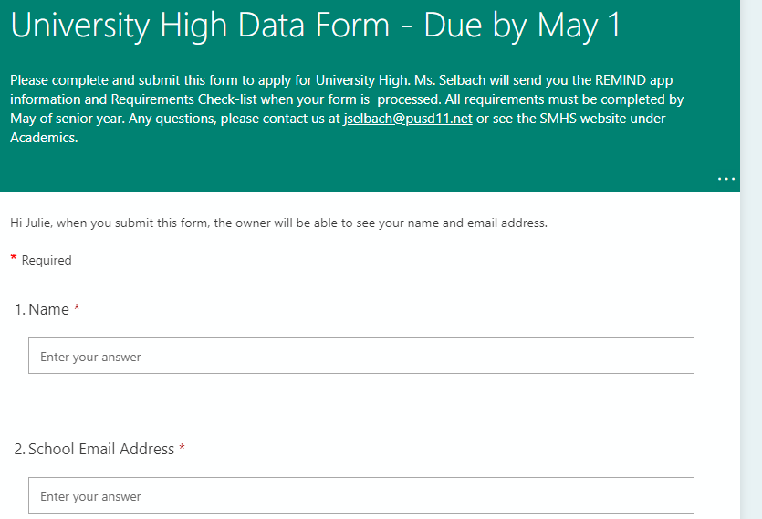

Slide 8
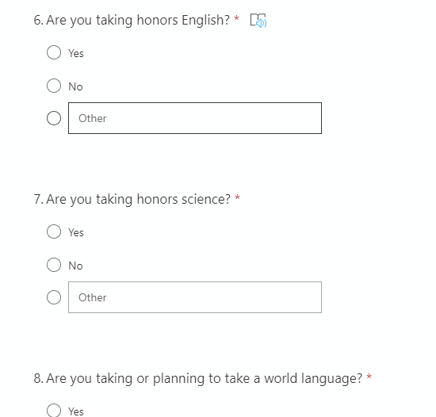

Slide 9
deadline – May 1

Slide 10
University High Endorsement Requirements
28 credits
3.25 cumulative GPA (as of December of the graduation year)
1 credit (120 hours) of community service
Complete a minimum of 6 AP exams
Earn a minimum of 30 college credits
Meet all PUSD graduation requirements in addition to completing the following courses:

Slide 11
Liberal Arts Endorsement
English
AIM English I H or English I H
English II H
English III H
College Prep H & AP Comp & Lit
Social Studies
Global Humanities (optional)
AP World History
AP US History
AP Government
AP Micro Econ, AP Macro Econ
AP European History (11th or 12th grade)
Languages (start by 10th grade)
Spanish I –IV
OR
German I – IV
Math
Algebra I
Geometry or Geometry H*
Alg II or Alg II H*
College Alg H
Pre-Calc H
*-dependent on Alg I grade/scores
Science
Pre-AP Biology
Pre-AP Chemistry
3rd science - choice

Slide 12
Math/Science Endorsement
Math
Algebra I
Algebra II H
Geometry H
College Algebra H
Pre- Calc H
Brief Calc (rec.)
AP Calc I
AP Calc II(optional)
Science
Pre-AP Biology
Pre-AP Chemistry
2 AP Sciences – AP Biology or AP Chemistry or AP Physics
5th science – choice
English
AIM English I H or English I H
English II H
English III H
College Prep H OR AP Comp & Lit
Social Studies
Global Humanities (optional)
World History or AP World History
US History or AP US History
AP Government
AP Micro Econ, AP Macro Econ
Languages
Spanish I – III (H) OR
German I – III (H)

Slide 13
Grade Point Average
UH Students are required to maintain a 3.25 GPA
Students who do not have a 3.25 at graduation will not receive the diploma endorsement

Slide 14
College Credit Options
Complete College Application Process
ASSET Placement Test
Dual enrollment costs –
Approx. $130- $180 based on credit hours
All University High students must take at least 6 AP exams
AP tests are given in May each year
AP tests cost approx. $94 per test
Dates and fees are set by the College Board
Dual Enrollment
Advanced Placement

Slide 15
AP Testing
AP tests are the most rigorous and respected option for college credits.
Competitive colleges prefer AP scores.
Many out-of-state schools will not take dual enrollment.
Choose the AP Exams that you are best prepared for so you can be successful.

Slide 16
Community Service
Outside school time, off campus, Volunteer for a Non-Profit Organization, 60 hours = ½ credit
Minimum of 120 hrs / 1 credit is required prior to graduation
Packets available in guidance (new packet for each 60 hours).
Requirements –
Non-profit & not on our campus
Supervised by non-relative
Time log
Journal
Essay
Supervisor’s evaluation.

Slide 17
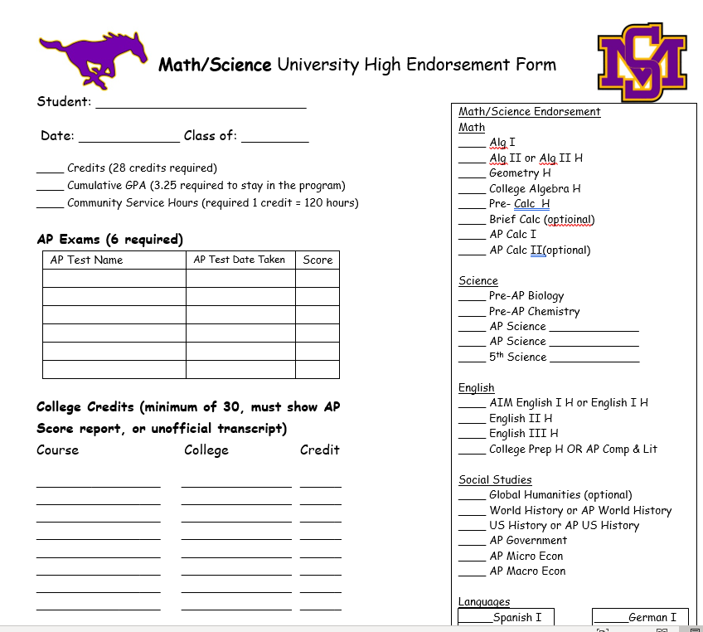

Slide 18
FAQ’s
How will students earn college credits and where will college classes be located?
dual enrollment
AP testing
Classes taken on a college campus
Who pays for college credits?
GCC Dual enrollment & AP Testing – Student pays

Slide 19
UH Benefits
College credits
Class rank
Rigorous college preparatory curriculum
Better prepared for college
Competitive colleges expect students to take most rigorous courses offered
Challenging course of study in comparison to other students
Endorsement on diploma
Recognition at graduation

Slide 20
Where to get information
Parent meeting –
Meet the Teacher
SMHS Website
Go to Academics
University High at Sunrise Mountain
Classroom presentations
Mustang Day
jselbach@pusd11.net

Slide 21
Questions? Please contact your counselor

